Slide 1

BrideBook
A/B test And Analytics

Slide 2
Objectives
Task overview
A/B Testing
EDA
PCA
Summary
Business Future Recommendations

Slide 3
OverView
Variant 0 Control Group
The product team wants more registered users to browse for venues and inquire.
By creating A/B test with three variants
Variant 1 Treatment group 1
Variant 2 Treatment group 2

Slide 4

Vital Questions will be answered
What was the outcome of this test?
What business recommendations would you suggest off the back of the results?
Are there any other findings/suggestions that come from the data?
What additional questions would you want to investigate given more time/data?
Any other comments or improvements that come to mind.

Slide 5

A/B Test
Hypothesis H0: Old and new pages are statistically indistinguishable.
H1: Control group and 2 treatment groups variation 1 and 2 of finalising operation differ significantly between groups’ pages

Slide 6
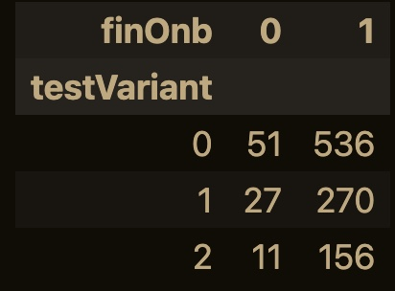
Contingency table by crosstab function shows:
users who finalized op from control group are 536,
treatment group one with testVarint 1 is 270,
and treatment group two with testVarint 2 is 156.

Slide 7
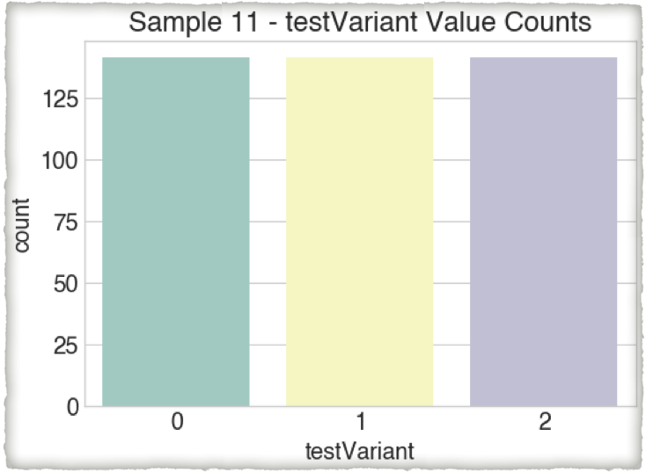
Proceeding with random sampling
3 groups, 10 samples Size as shown

Slide 8
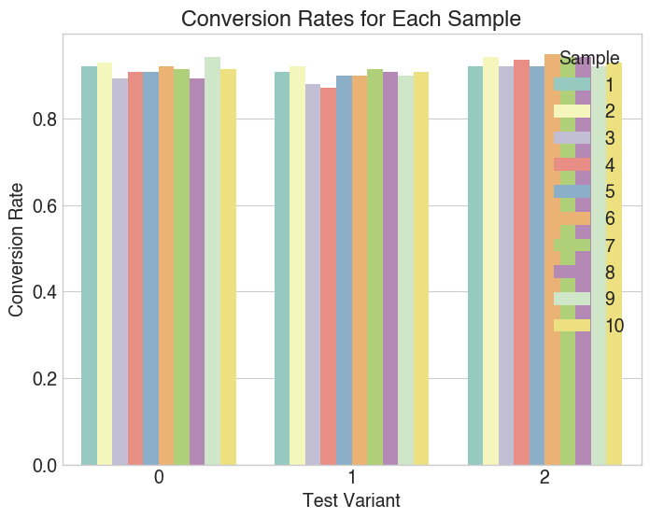
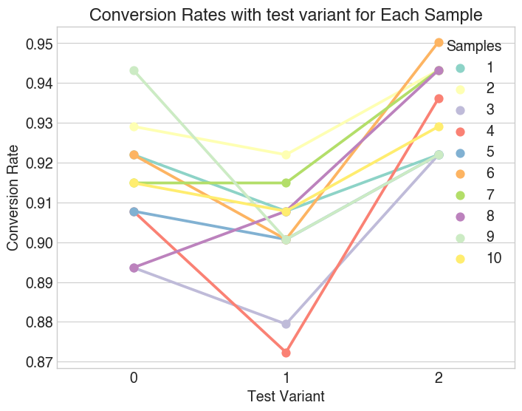
Checking conversion rates and plot it with multipe Random Sampling and calculating
Values will be continued further on
Conversion Rate:

Slide 9
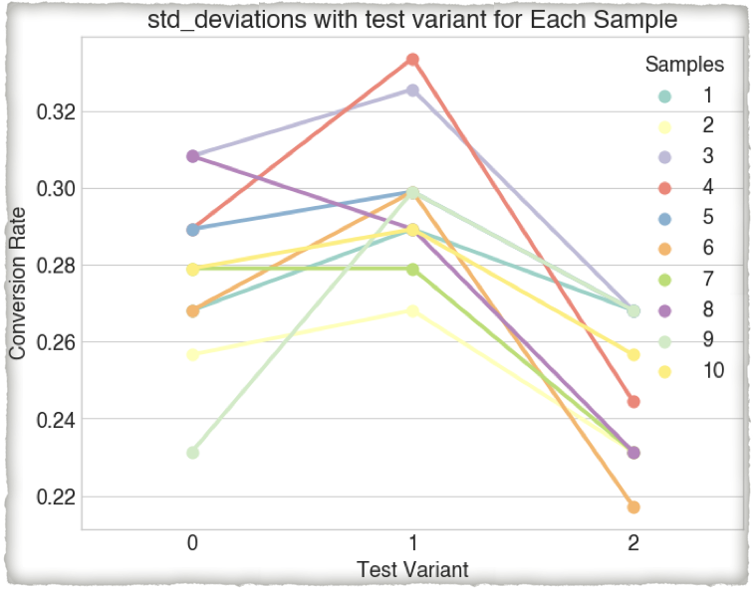
Variant 2 has consistent deviation values, while variant 1 has discrepancies.
Standard Deviation

Slide 10
rates imply that 95% and 92% of total visits on our digital assets resulted in the intended user actions, as variant 2 in our case hid the text of variant 2
Conversion Rate:

Slide 11
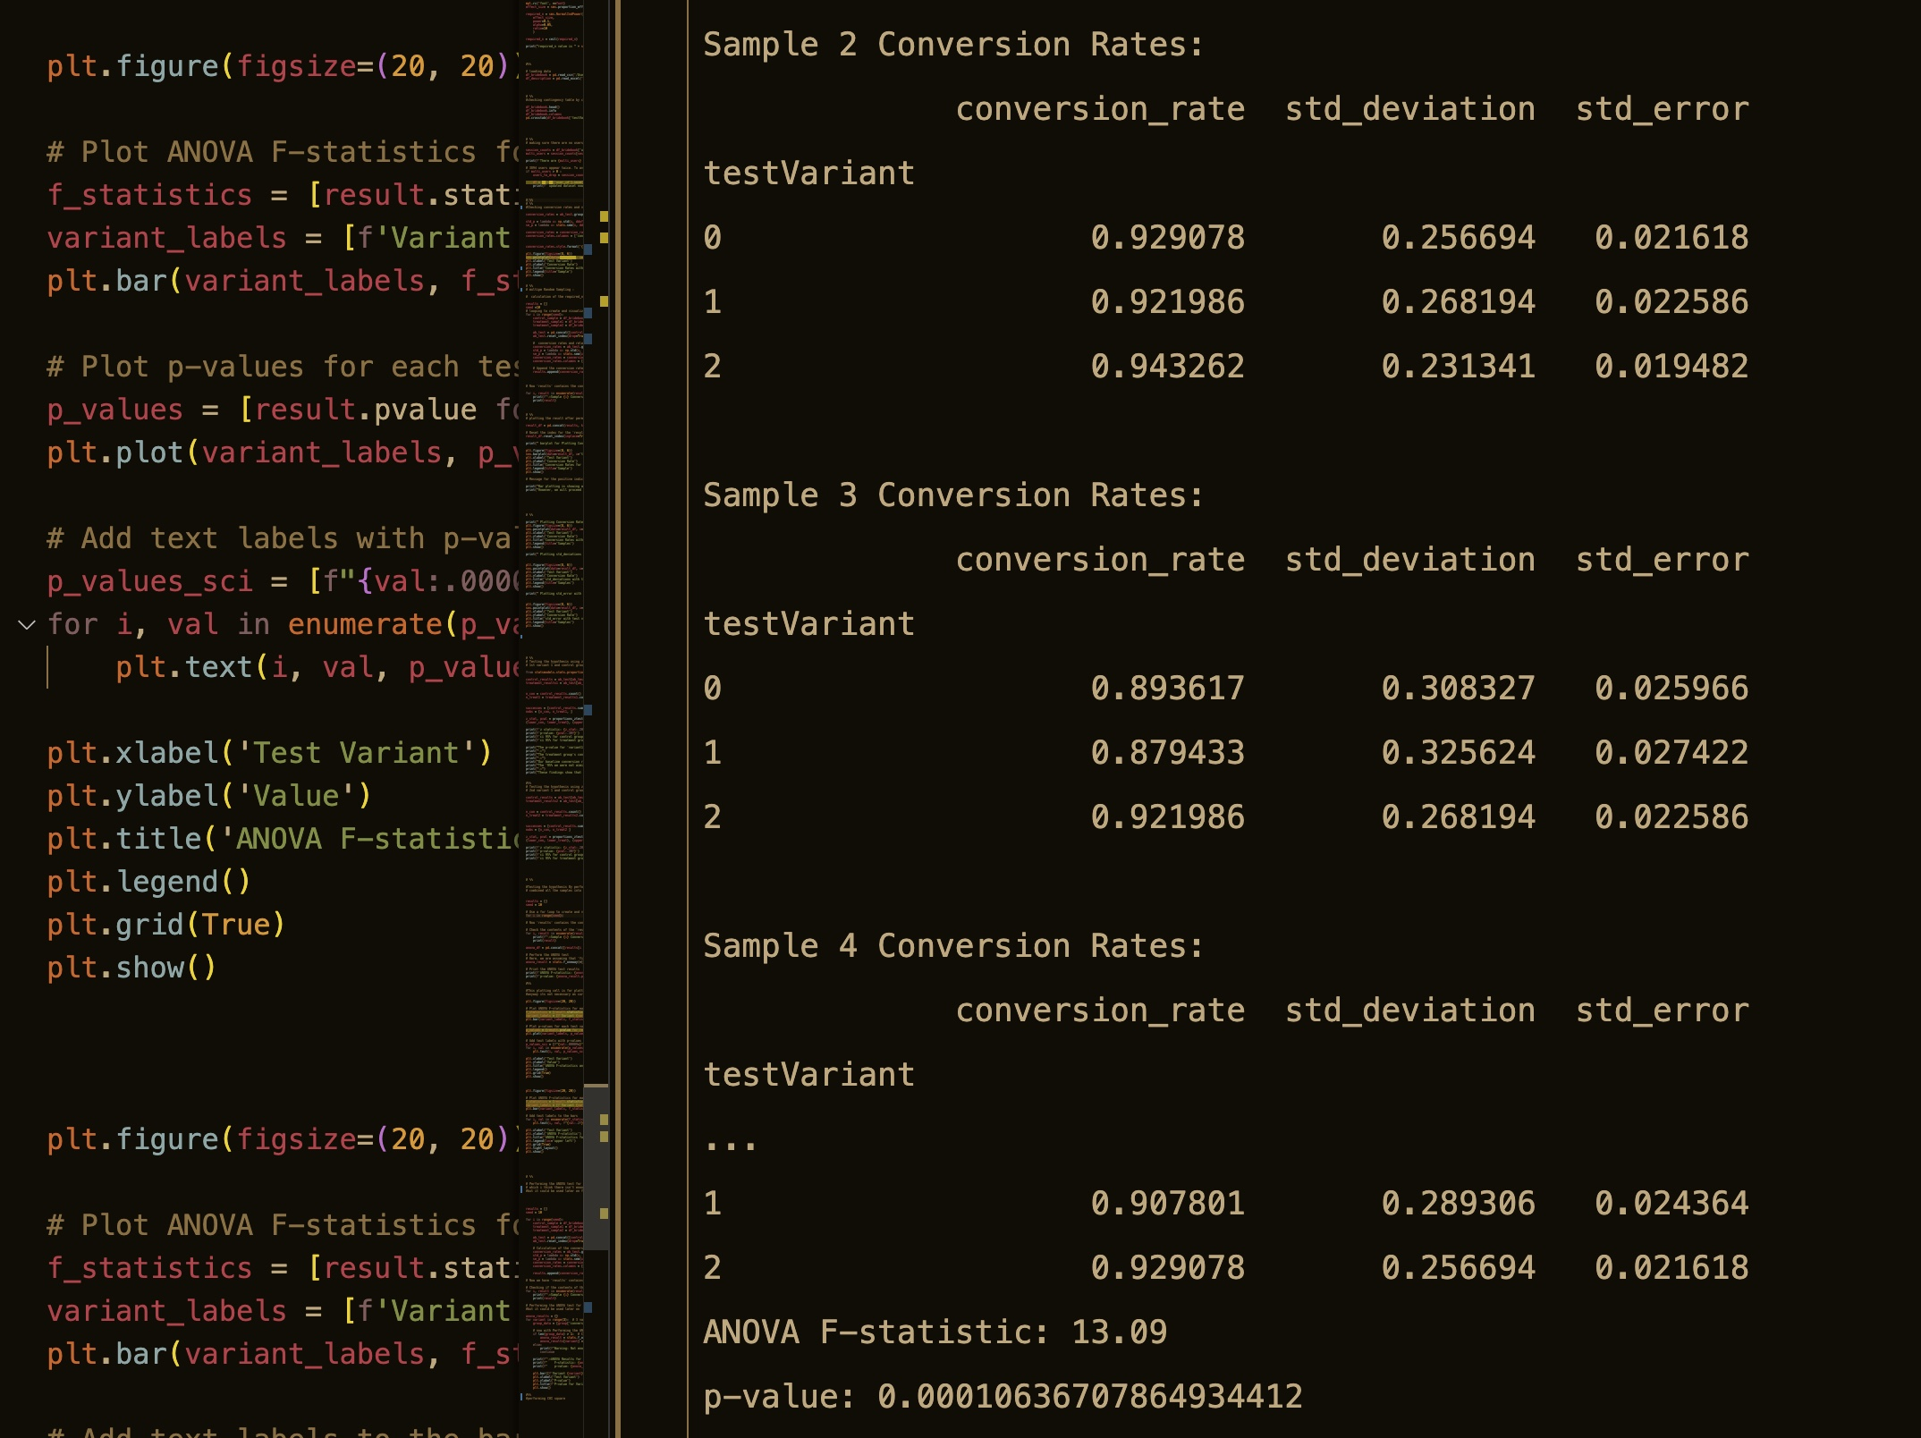
ANOVA F-statistic: Compares group means to variability. F-statistic 13.09. A higher F-statistic indicates a greater difference between group means than group variance.
P-value: the probability of receiving the reported results (or worse) assuming no genuine difference between group means. It's 0.00010636707864934412. This p-value (less than 0.05) suggests statistically significant group mean variation.
Hypothesis testing:

Slide 12
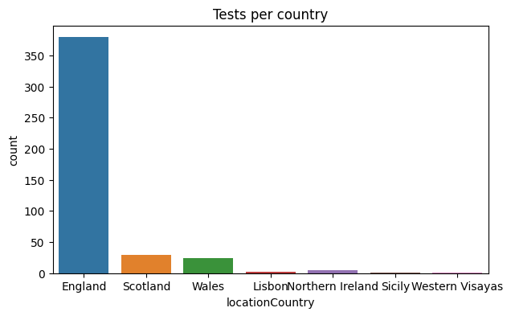
English users dominate. Scotland, Wales However, England has the biggest user density, thus growth ambitions may include other countries!
Exploratory Analysis

Slide 13
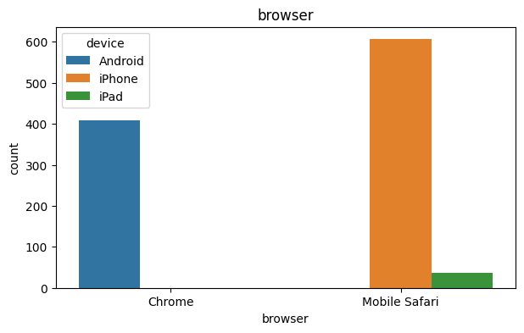
Iphone(with safari) is the most common device used with around 600 users compared to around 400 users of Android(with chrome)
Exploratory Analysis

Slide 14
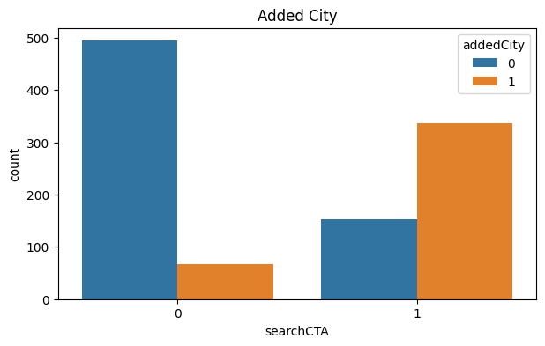
The relation and assess user ratios for each feature. The next graph illustrates that people who add the city are more likely to search "CTA" (orange bar).
Exploratory Analysis

Slide 15
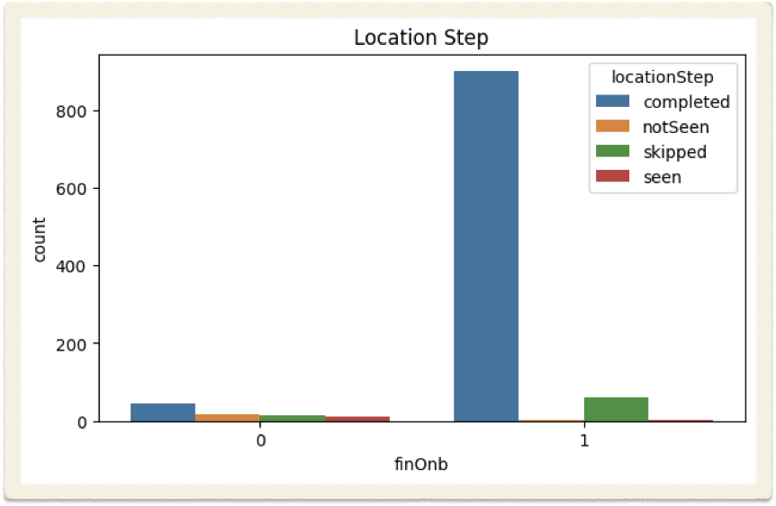
Finish on boarding users are more likely to have completed the city location stage. with a sizable portion of individuals bypassing the "location" stage.
Exploratory Analysis

Slide 16
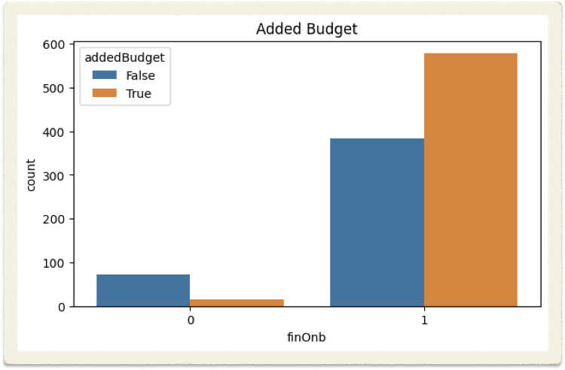
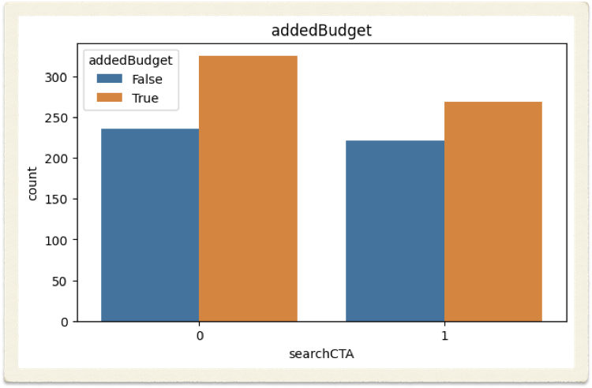
As can be seen in the graphs, users who added the budget went on to be on board and Search CTA, demonstrating the feature's influence and significance.
Exploratory Analysis

Slide 17
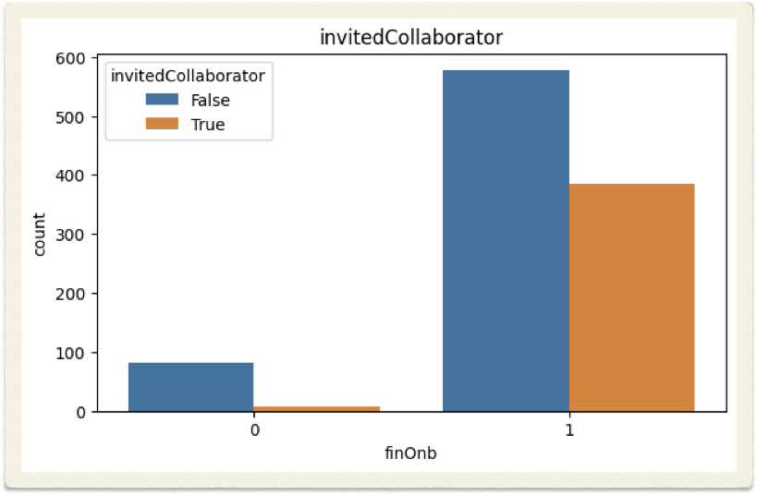
When it comes to the invite collaborators option, data reveals that customers who didn't use it are still motivated to get on board and keep looking.
Exploratory Analysis

Slide 18
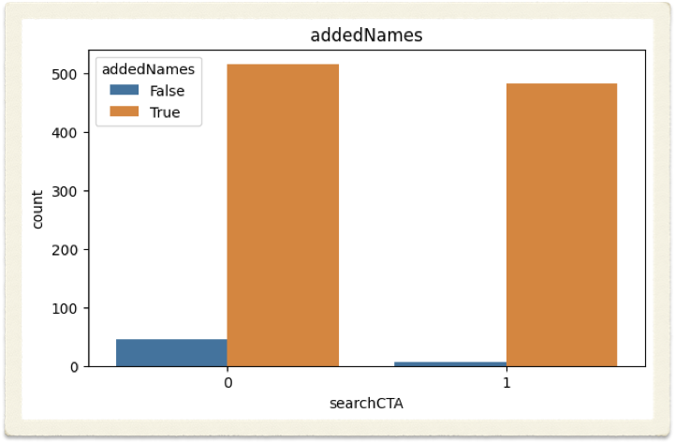
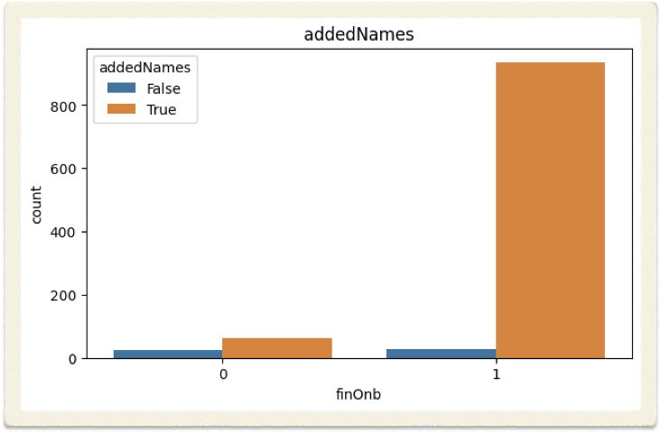
The outcomes provided us some hints that users who didn't add people to their lists were somewhat more likely to click the CTA compared to those who did.
However, those who add names are statistically significantly more likely to remain on board.
Exploratory Analysis

Slide 19
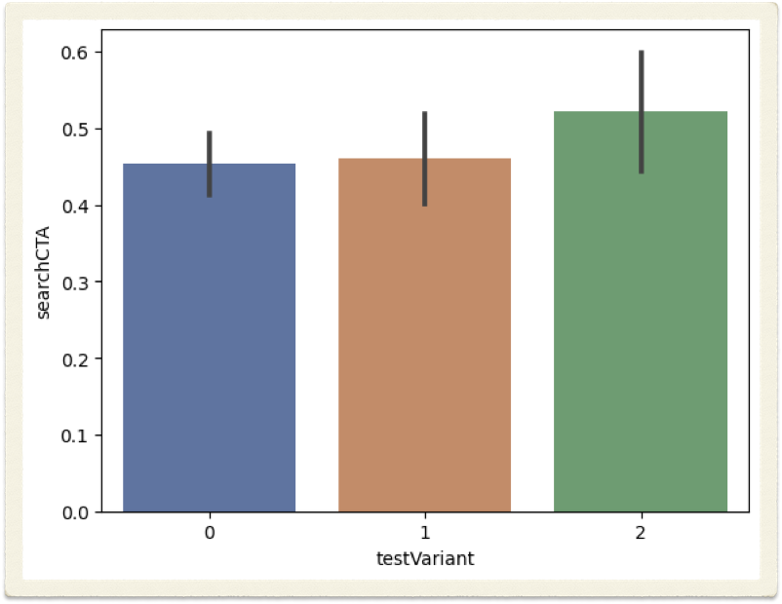
The following graph is portraying that control to action performs better with variant 2.
Exploratory Analysis

Slide 20
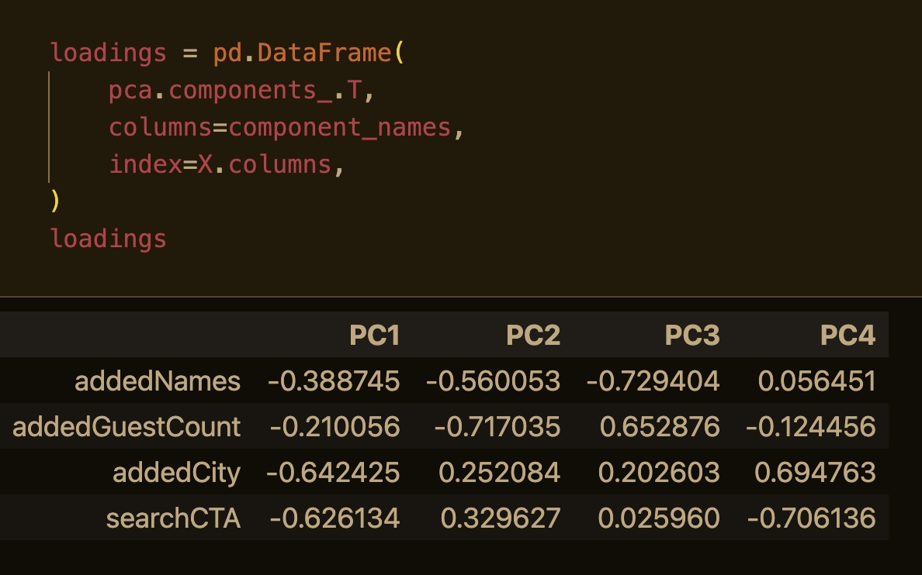
The original features have been combined after standardization linearly in an orthogonal approach to generate these principle components, which capturethe largest turbulence in the data.
And the outcome is plain to observe.
Principle Component Analysis

Slide 21
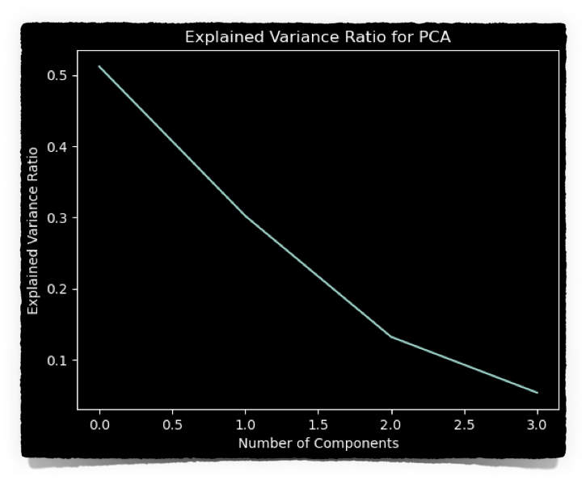
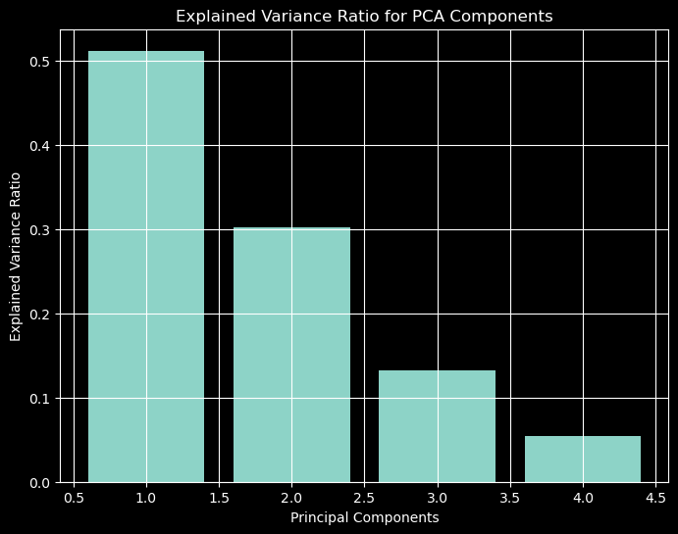
The previous graph shows the variance ratio, and we can determine that the first component has the highest ratio. The next bar graph proves and indicates that!
Principle Component Analysis

Slide 22
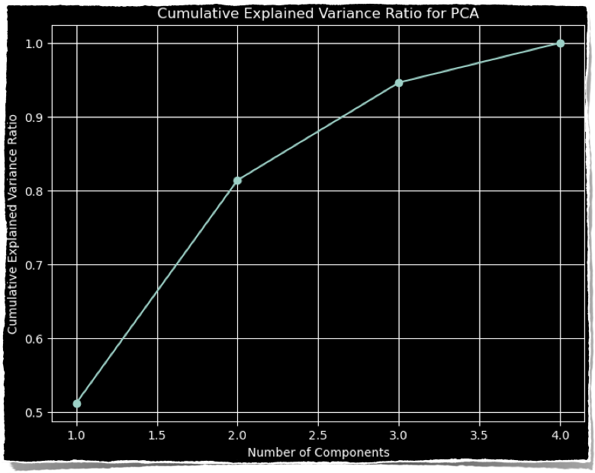
PCA Cumulative Explained Variance Ratio. Although PC1 is informational, the remaining components nevertheless contribute to finishing the steps despite their humble fluctuation. To identify neglected associations and investigate these subfactors.
Principle Component Analysis

Slide 23
AI analyses user data and activity to personalise services, suggestions, and experiences.
AI-predictive maintenance prevents system failures. This saves downtime and increases product dependability by gathering and training more data on other ML models and fetching the features output to the present model to shorten loading time for suggestions like venues and quotas.

Slide 24
Enhancing the user interface for people with disabilities Dyslexics can plan for personalised personal support for mobility-disabled people.
England wedding rates prediction Since most of our consumers are in England, studying divorce and wedding rates for the next 6-12 months could help us better serve them and attract more. How? Study the causes and develop a campaign to educate individuals through articles and videos to achieve marital stability and encourage others to take further step.
So we can stray a little on our business model with concentration on relationship psychology, but that will extend our market and expose our fundamental purpose of gathering people together and distributing the knowledge to preserve and secure our relationships with love.

Slide 25
Any Questions?

Slide 26
Thank You

